Slide 1
3D MAPPING CLOUD
June 2017 CONFIDENTIAL - For Orbit GT Resellers Only

Slide 3
View, Fuse, Share, Publish, Integrate and Sell all 3D Mapping data
a SaaS based Web App & Platform for All Imagery and Point Cloud data

Slide 4
Superb HTML5 Streaming Powerful Viewing, Sharing & Integration Capabilities
HTML5 Viewing on all platforms & Free SDK

Slide 5
Self-Service
Manage Users and Data Marketplace
Use the Online Cloud Console

Slide 6
3D Mapping Cloud
Why ?

Slide 7
3D Mapping Cloud - Portfolio Position
Collect & Prepare Import
Catalog / Explore
Verify
Correct Positional Accuracy
Clean Point Cloud
Plan re-runs
Deliver MM Content
Upload to the Cloud
Extract Features
Asset Inventory Workflows
Automated Extraction tools
Clash Detection
Profiles & Cross Sections
Volumes
Face & Plate Blurring QC
Deliver Features
Consume via Web
Consume via App
Consume via SDK
Plugins / Integrations
Embed in Workflow
Share with 3rd parties
Publish On-Premises
Integrate with other 3D data
Share in the Cloud
Publish in the Cloud
© Orbit GT www.orbitgt.com, 2017
Orbit 3D Mapping v17.0 - Confidential

Slide 8
3D Mapping Cloud - Portfolio Position
Publisher
Mobile Mapping / Oblique Only
Publications only
(no free choice of resources)
Own IT/ Hardware & TCO
On Premises
Purchase
3D Mapping Cloud
All sources (Incl. UAV, Indoor, TLS, ..)
‘Desktop’ style UI
Pick from Catalog
share single Resource ad hoc
share via Publication
share via SDK / Integration
Fuse any data
also 3rd party data
SaaS : No (IT) overhead
Monthly / Yearly
© Orbit GT www.orbitgt.com, 2017
Orbit 3D Mapping v17.0 - Confidential

Slide 9
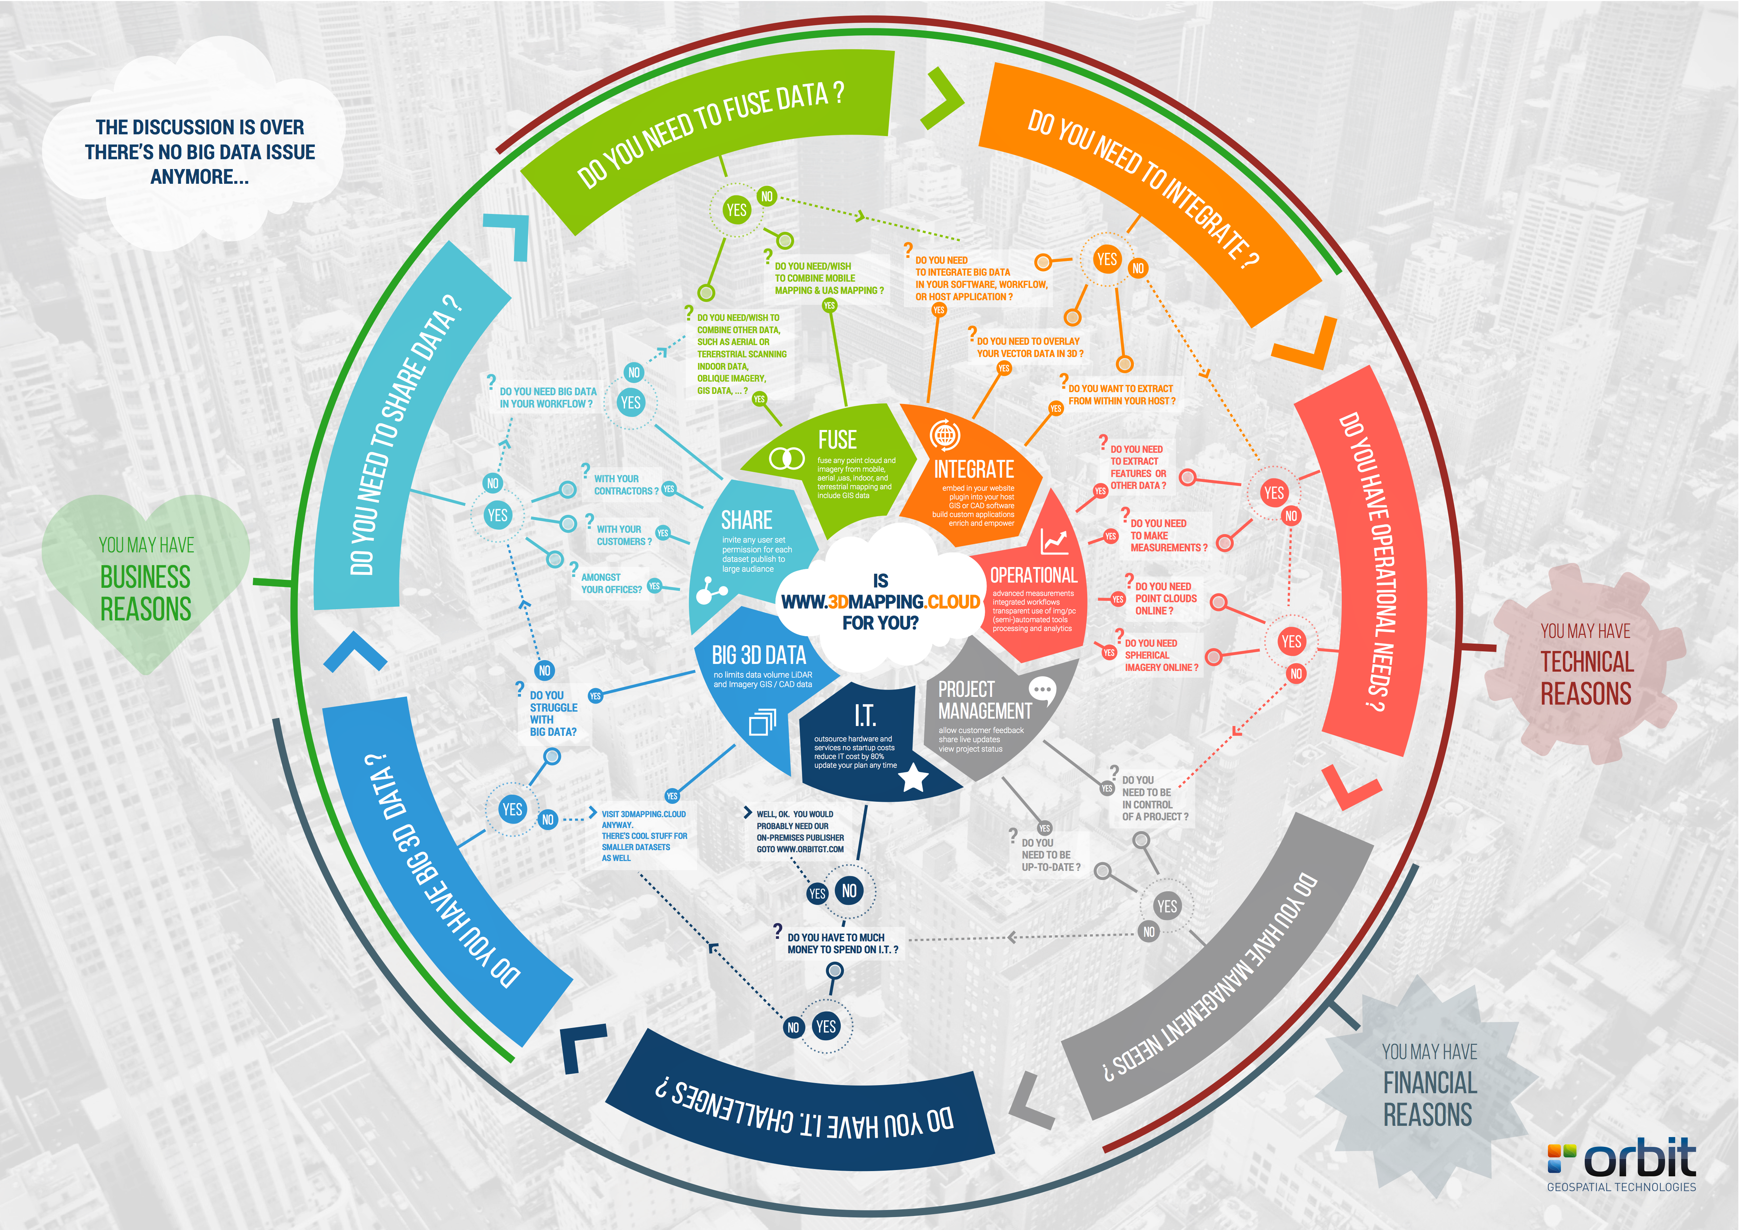

Slide 10
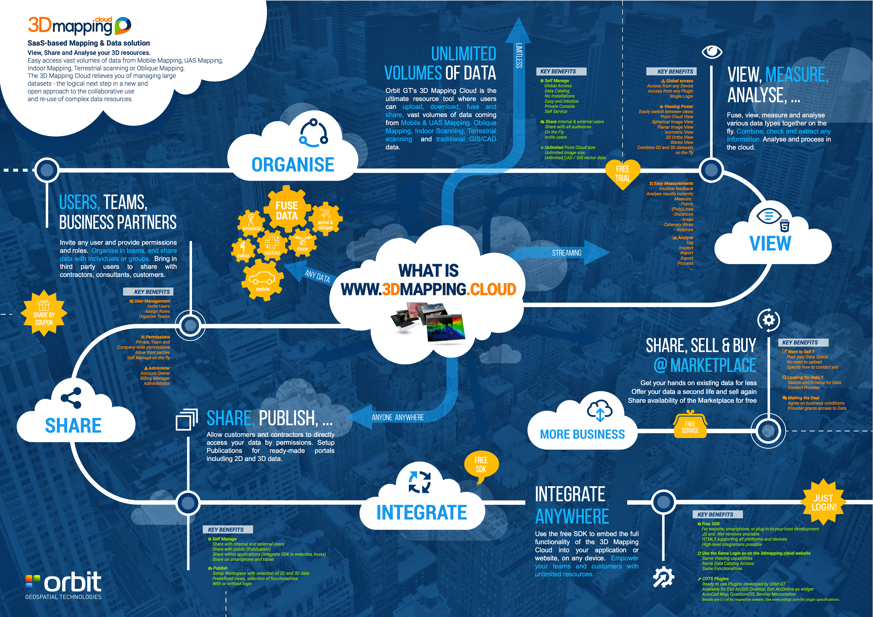

Slide 11
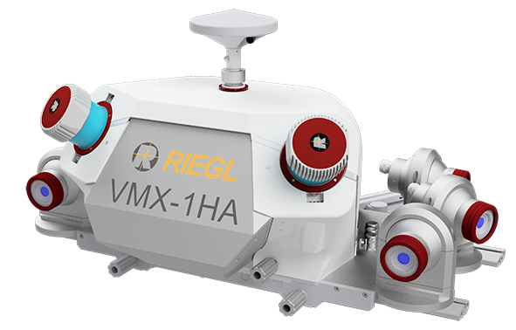
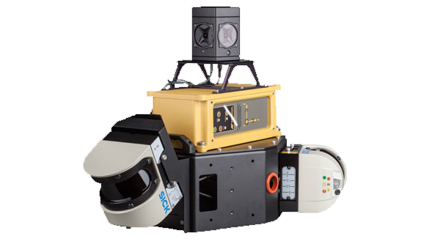
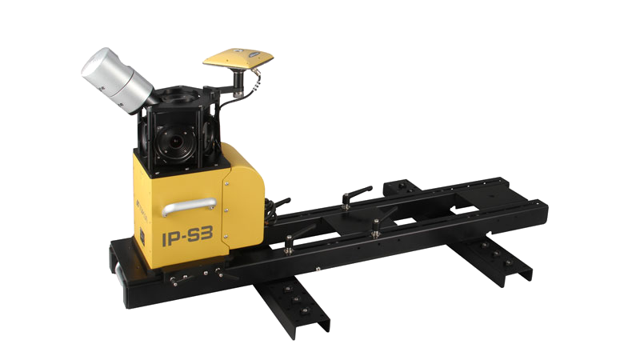
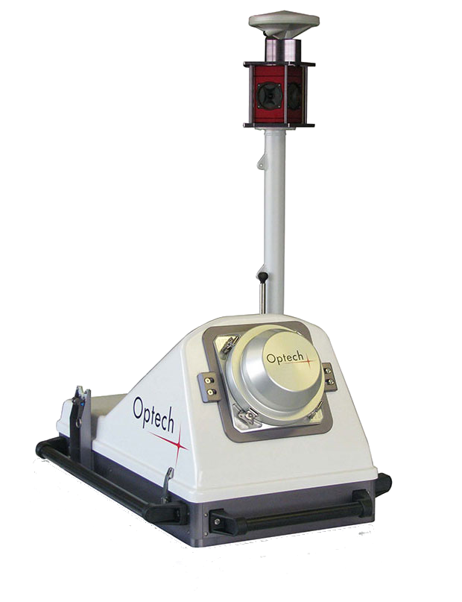
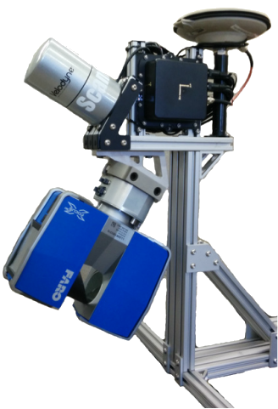
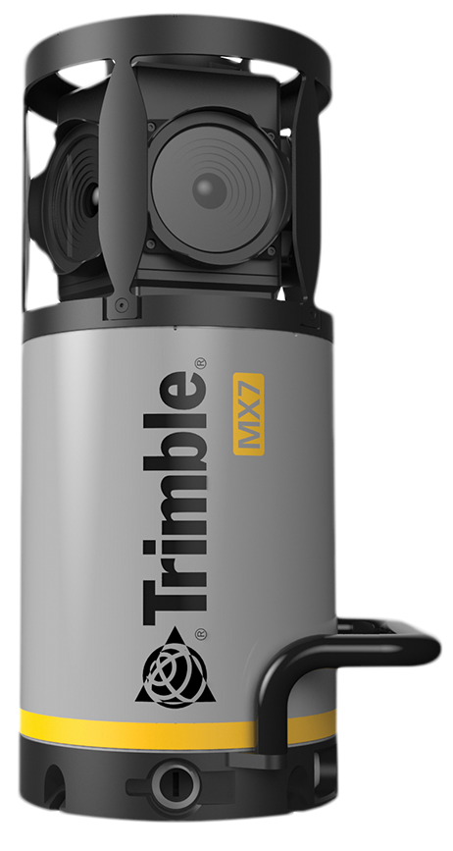
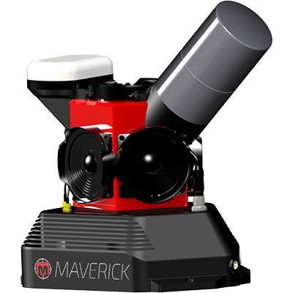
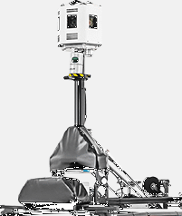
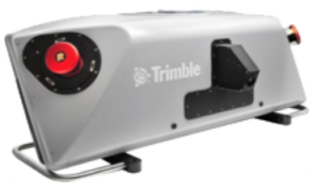
Strong Industry Support
© Orbit GT www.orbitgt.com, 2017
Orbit GT - 3D MAPPING CLOUD

Slide 12
Strong Industry Support
© Orbit GT www.orbitgt.com, 2017
Orbit GT - 3D MAPPING CLOUD

Slide 13
All Data
IMAGERY
POINT CLOUD METADATA
1 RESOURCE
© Orbit GT www.orbitgt.com, 2017
Orbit GT - 3D MAPPING CLOUD

Slide 14
Limitless Data
SERVING TODAY
300+ TB
40 000 000 SPHERICAL images
Billions of billions of POINTS
© Orbit GT www.orbitgt.com, 2017
Orbit GT - 3D MAPPING CLOUD

Slide 15
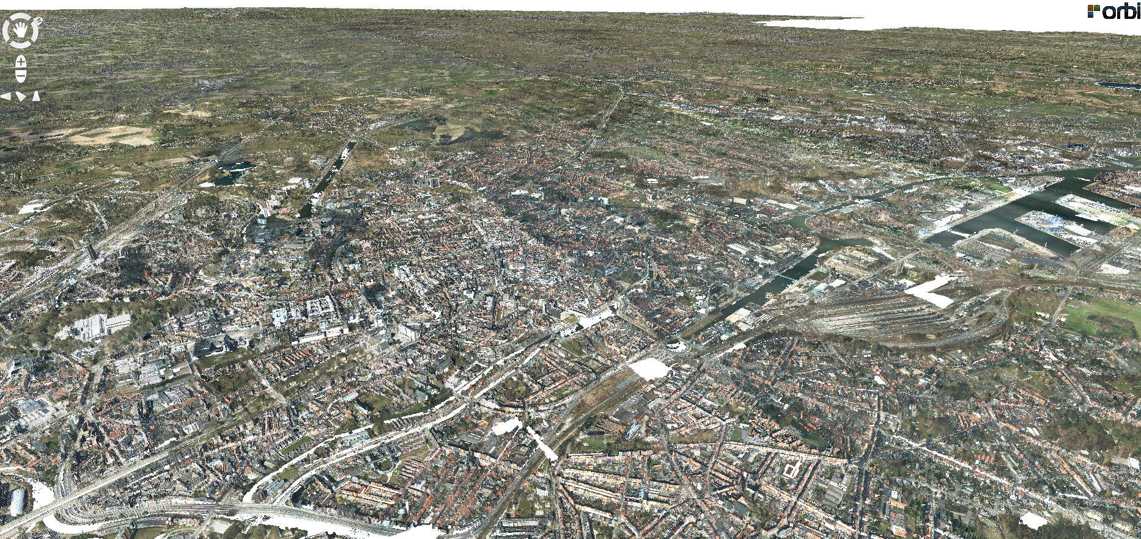
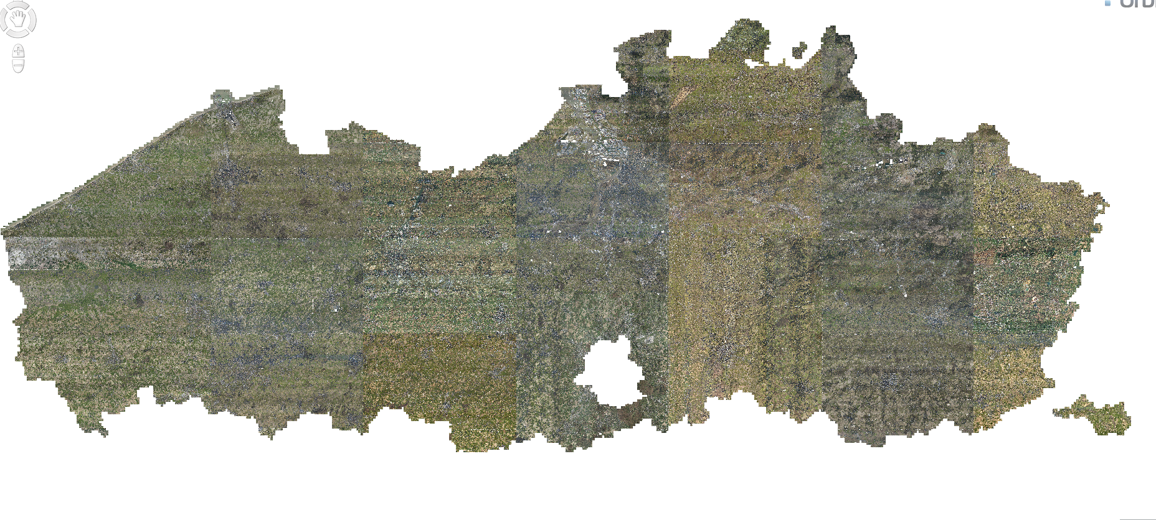
1 Aerial Lidar Example
5.5 TB
342,264,676,968 POINTS
( used to be 176,650 LAS TILES ! )
© Orbit GT www.orbitgt.com, 2017
Orbit GT - 3D MAPPING CLOUD

Slide 16
All Users
© Orbit GT www.orbitgt.com, 2017
Orbit GT - 3D MAPPING CLOUD

Slide 17
Customers, Contractors, Anyone
© Orbit GT www.orbitgt.com, 2017
Orbit GT - 3D MAPPING CLOUD

Slide 18
YOUR workflow - FREE SDK
© Orbit GT www.orbitgt.com, 2017
Orbit GT - 3D MAPPING CLOUD

Slide 19
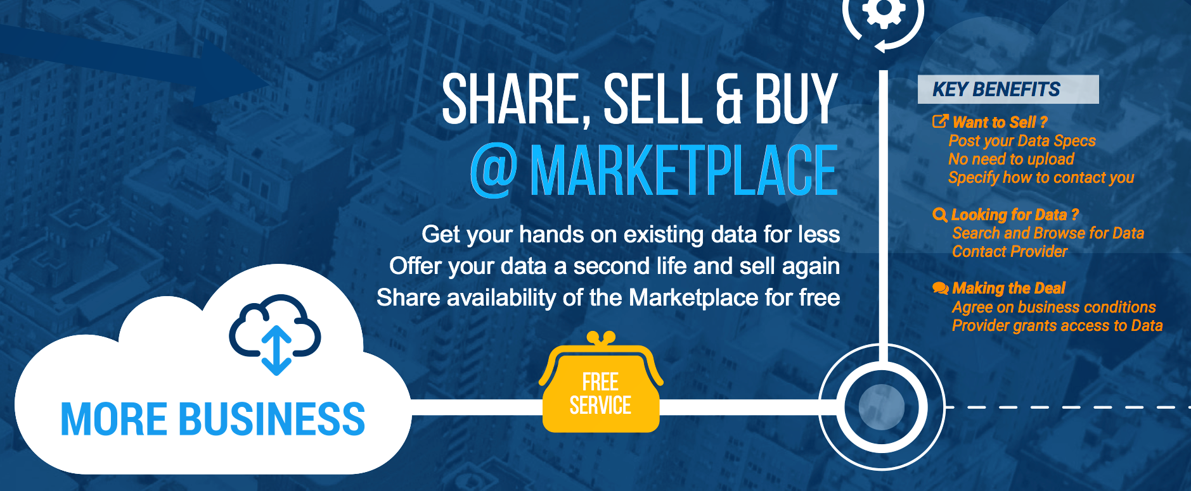
And Monetise your content
© Orbit GT www.orbitgt.com, 2017
Orbit GT - 3D MAPPING CLOUD

Slide 20
3D Mapping Cloud - Market Position
Strong Industry Support
Unlimited Data Volume support
Not Just Point Clouds
Not Just Images
Not Just a Web Application
Guaranteed Compatibility
Multi-Sensor, Exact, Integrated
Fusion of Data
Built to Catalog, Share, Collaborate, Publish and Integrate
© Orbit GT www.orbitgt.com, 2017
Orbit 3D Mapping v17.0 - Confidential

Slide 21
3D Mapping Cloud - Status
Where are we today ?
Usage
Register as Trial User (14 days)
Register as new Account, with Plan
Invite co-workers Automated payments
Change Plan on demand
Supported Data
Mobile Mapping data (upload via MM Content Manager)
UAS data (upload via UAS Mapping)
Vector data (upload via both above)
Viewer Capabilities
Point Cloud streaming
Spherical Imagery
Planar Imagery
Pick and combine any resource from your Catalog
Various Measurements
Sharing
Share within organisation
Share with 3rd party organisation or individual
© Orbit GT www.orbitgt.com, 2017
Orbit 3D Mapping v17.0 - Confidential

Slide 22
3D Mapping Cloud - Status
What’s coming next ?
Usage
Coupons & Teams
Supported Data
Oblique Imagery & DEM, Indoor
2D Resources / Basemaps
Viewer Capabilities
Oblique, Indoor
2D Map
Triangulation Measurements
SDK
Javascript
ArcOnline Widget
Publications
Preset Resources
Settings
Concurrent Users
2D Map
SDK compatible
Dynamic Availability
On-Premises Publisher
HTML5-based Viewer and SDK
Data Upload
FREE UPLOAD TOOL
© Orbit GT www.orbitgt.com, 2017
Orbit 3D Mapping v17.0 - Confidential

Slide 23
PARTNER TASKS

Slide 24
Partner Tasks - Get Started
Get Started with 3DMC
Create your corporate account
Upload some great example data
Share with your customer
Launch the customer with a Coupon
(available mid July 2017)
Build Reference Cases
Continue to engage customers
Provide feedback to us
EUR 120/mo - USD 144/mo
EUR 50/TB/mo - USD 60/TB/mo
FREE
One time EUR 120 - USD 144
© Orbit GT www.orbitgt.com, 2017
Orbit 3D Mapping v17.0 - Confidential

Slide 25
Partner Tasks - Get Started
Let’s walk you through the most important steps
How to Register
How to Upload Data
How the Viewer and Measurements work
How to Share with someone
https://3dmapping.cloud/sign-up-guide/
https://3dmapping.cloud/about-upload-tools/
https://3dmapping.cloud/getting-started-with-the-viewer/
https://3dmapping.cloud/new-measurement-tools/
https://3dmapping.cloud/about-sharing-resources/
© Orbit GT www.orbitgt.com, 2017
Orbit 3D Mapping v17.0 - Confidential

Slide 26
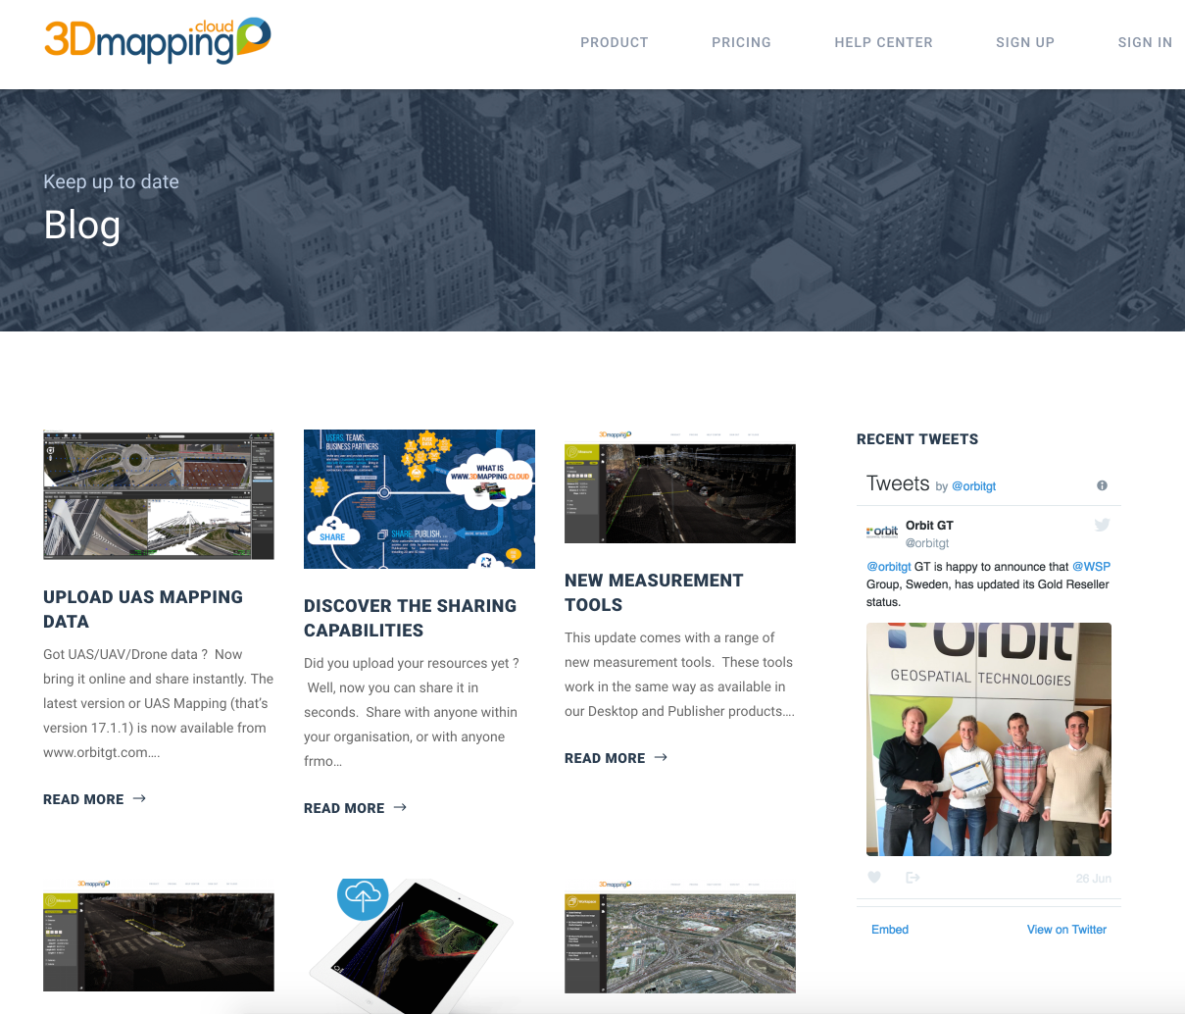
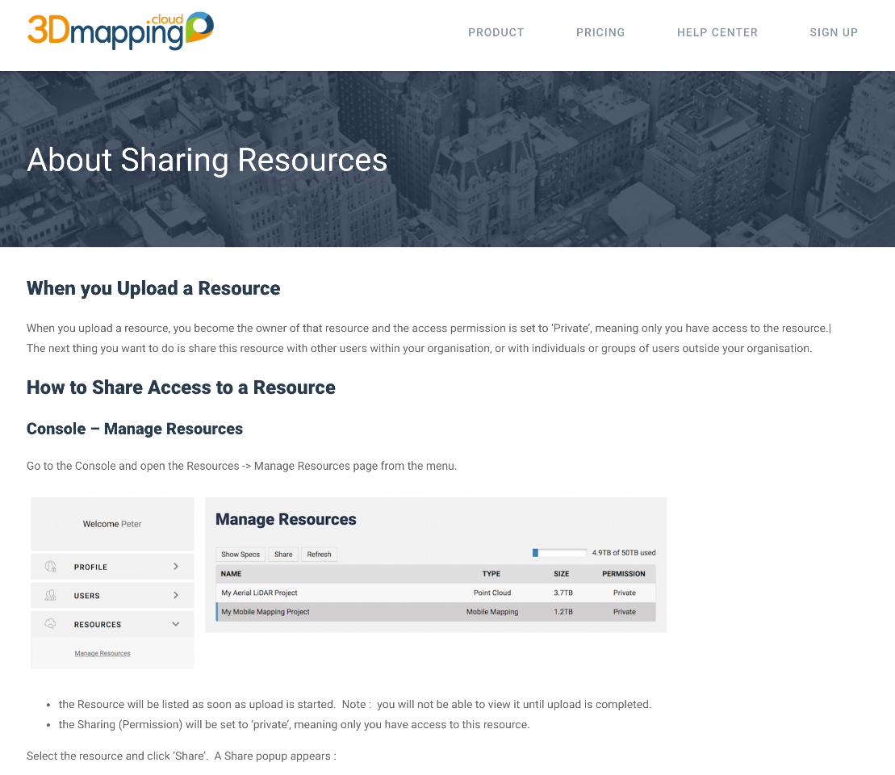
Partner Tasks - Follow Up
3DMC has very regular updates
Read / Share the Blog
Read Dedicated Pages
© Orbit GT www.orbitgt.com, 2017
Orbit 3D Mapping v17.0 - Confidential

Slide 27
Partner Tasks - Social Promote
Follow us on the various Social Media that we post
Linked In :
Facebook
Twitter
And REPOST our posts to spread the word
Share your example data
Share your best and most impressive example dataset with us
Trial datasets must be excellent example and preferably large
© Orbit GT www.orbitgt.com, 2017
Orbit 3D Mapping v17.0 - Confidential

Slide 28
Next : Partner Meeting
Save the Date :
Mon. Sept 25, 2017
Intergeo, Berlin
Releases : v18 and 3DMC
Partner Valuation Program
Agenda and location tba
© Orbit GT www.orbitgt.com, 2017
Orbit 3D Mapping v17.0 - Confidential

Slide 29
1. Get Started
2. Follow Blogs
3. Follow and Share on Social Media
4. Build Cases
5. Partner Meeting at Intergeo
5 Take-Aways

